Slide 1
HTML5 Essentials & Semantic Markup
Manal Asghar

Slide 2
What is HTML5?
Latest version of HTML
Introduced new semantic tags
Better support for multimedia
Mobile-friendly
HTML5 makes websites more structured and meaningful.

Slide 3
Data Types, Attributes & Entities
Data Types (Basic Values)
Text
Number
URL
Email
E.g. <input type="email">

Slide 4
HTML Attributes
HTML attributes provide additional information about HTML elements.
All HTML elements can have attributes
Attributes provide additional information about elements
Attributes are always specified in the start tag
Attributes usually come in name/value pairs like: name="value“

Slide 5
Hyperlink
Connects web pages to each other.Lets users navigate from one page or website to another.
Tag <a> (anchor)
The <a> tag defines a hyperlink. The href attribute specifies the URL of the page the link goes to:
<a href="https://www.w3schools.com">Visit W3Schools</a>
href → URL of the page you want to link to.Text between <a> and </a> → clickable text.

Slide 6
Image tag with Attributes
Src Attributes:
The <img> tag is used to embed an image in an HTML page. The src attribute specifies the path to the image to be displayed:
<img src="img_girl.jpg">

Slide 7
SRC Attribute
There are two ways to specify the URL in the src attribute:
1. Absolute URL - Links to an external image that is hosted on another website. Example: src="https://www.w3schools.com/images/img_girl.jpg".
2. Relative URL - Links to an image that is hosted within the website. Here, the URL does not include the domain name. If the URL begins without a slash, it will be relative to the current page. Example: src="img_girl.jpg". If the URL begins with a slash, it will be relative to the domain. Example: src="/images/img_girl.jpg".
Tip: It is almost always best to use relative URLs. They will not break if you change domain

Slide 8
Image tag with Attributes
The width and height Attributes:
The <img> tag should also contain the width and height attributes, which specify the width and height of the image (in pixels):
<img src="img_girl.jpg" width="500" height="600">

Slide 9
style Attribute
The style attribute is used to add styles to an element, such as color, font, size, and more.
<p style="color:red;">This is a red paragraph.</p>

Slide 10
Entities
Entities Special symbols in HTML.
&lt; → <
&gt; → >
&copy; → ©

Slide 11
Container vs. Standalone Tags
Container Tags: Have opening and closing tags
<p>Hello</p>
<h>Hi<h>
Standalone (Empty) Tags: No closing tags
<br> <img> <hr>

Slide 12
Semantic Tags
Semantic = Meaningful tags
Instead of using only <div>, HTML5 gives meaningful tags:
<header> – Top section
<main> – Main content
<article> – Independent content
<section> – Group of content
<footer> – Bottom section
Semantic tags improve: Readability and Structure

Slide 13
HTML5 for Mobile Devices
Responsive design support
Viewport meta tag
<meta name="viewport" content="width=device-width, initial-scale=1.0">
Makes website adjust on mobile screens

Slide 14
Accessibility (aria-*)
Accessibility helps:
Visually impaired users
Screen readers
<button aria-label="Close">X</button>
aria-label gives extra description for assistive tools.

Slide 15
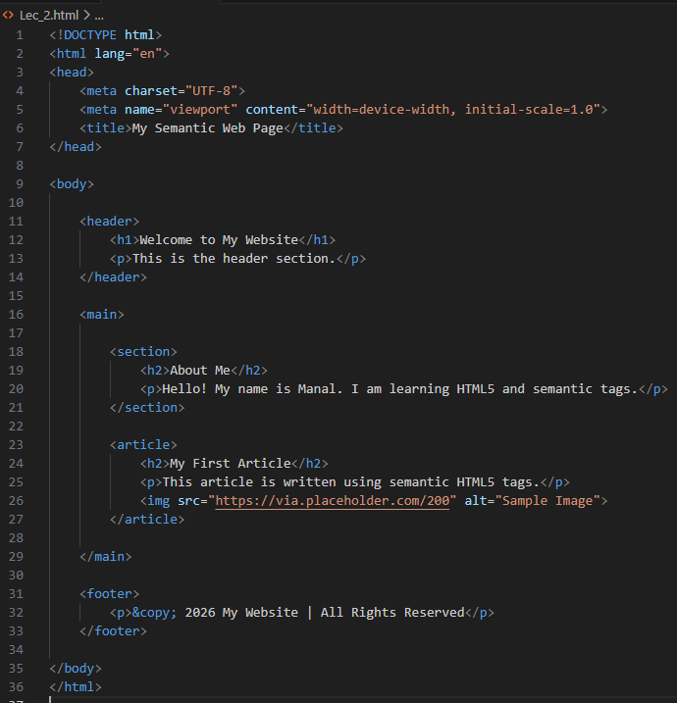
Practical Task : create a semantic web page
using:
<header>
<main>
<section>
<article>
<footer>
Include:
Heading
Paragraph

Slide 16
HTML List:
HTML lists allow web developers to group a set of related items in lists.
Organize content in a structured way.
Can be ordered (numbers) or unordered (bullets).
Types of Lists:
Ordered List
Unordered List
Description list

Slide 17
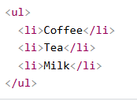
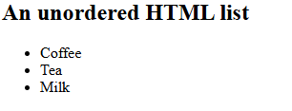
Unordered HTML List
An unordered list starts with the <ul> tag. Each list item starts with the <li> tag.
The list items will be marked with bullets (small black circles) by default:

Slide 18
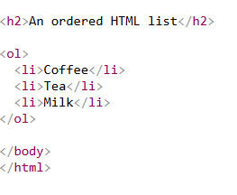
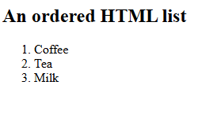
Ordered HTML List
An ordered list starts with the <ol> tag. Each list item starts with the <li> tag.
The list items will be marked with numbers by default:

Slide 19
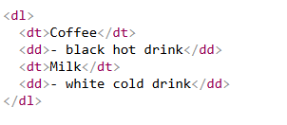
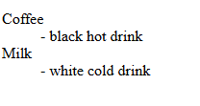
HTML Description Lists
HTML also supports description lists.
A description list is a list of terms, with a description of each term.
The <dl> tag defines the description list, the <dt> tag defines the term (name), and the <dd> tag describes each term:

Slide 20
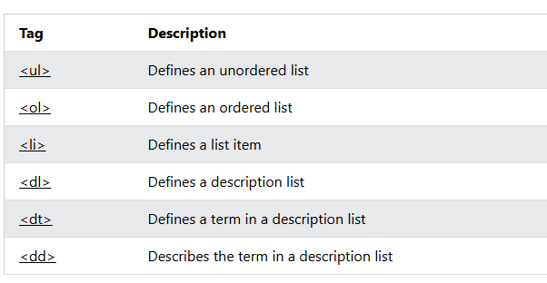
HTML List Tag

Slide 21
Text formatting Tags
Formatting Type | Tag | Description | Example
Bold | <b> | Makes text bold (visual purpose only). | <b>Bold Text</b>
Strong | <strong> | Shows important text (semantic meaning + bold). | <strong>Important</strong>
Italic | <i> | Makes text italic (visual purpose). | <i>Italic</i>
Emphasis | <em> | Emphasizes text (semantic meaning + italic). | <em>Important Word</em>
Underline | <u> | Underlines the text. | <u>Underlined</u>
Highlight | <mark> | Highlights text with yellow background. | <mark>Highlighted</mark>

Slide 22
Text formatting Tags
Formatting Type | Tag | Description | Example
Deleted Text | <del> | Shows deleted or removed text (strikethrough). | <del>Old Price</del>
Inserted Text | <ins> | Shows newly added text (usually underlined). | <ins>New Text</ins>
Subscript | <sub> | Text below normal line (chemistry formulas). | H<sub>2</sub>O
Superscript | <sup> | Text above normal line (math powers). | x<sup>2</sup>
Block Quote | <blockquote> | For long quotations. | <blockquote>Long quote</blockquote>
Preformatted | <pre> | Keeps spaces and line breaks as written. | <pre>Formatted text</pre>

Slide 23
Practical Task
Create an HTML page using headings and one paragraph about yourself. Use at least 5 text formatting tags (bold, italic, underline, mark, sub, sup).Add one unordered list (with type attribute) and one ordered list (with type or start attribute)add your favorite website link.

Slide 24
